Slide 1

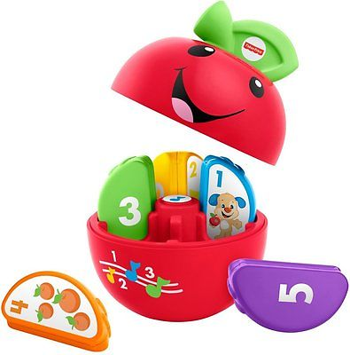
Laugh & Learn Learning
Happy Apple
Toy Name
Laugh & Learn Learning Happy Apple
Manufacturer
Fisher Price
Age
6 – 12 months
Parts
1 Roly Poly Apple Base
5 Apple Slices
Develop Skills
Fine Motor
Linguistic
Imagination
Cognitive
How it Works
Tekan bagian inti dari apel untuk mendengar lagu dan kalimat menyenangkan dan pukul apel untuk mendengar suara-suara lucu. Keluarkanlah irisan apel untuk mempelajari angka.
-
Press the core of the apple to hear fun songs and phrases and bat the apple to hear silly sounds and chimes. Take out the “slices” to learn about numbers.
How To Clean
Simply clean using a cloth that has been sprayed with non-toxic anti bacterial solution
Warning
Do not wash/soak in water
Store in a dry place
Keep out of direct sunlight

